Slide 1
Constructors of String Buffer Class
momedaram

Slide 2
Constructors of StringBuffer Class, provides many ways to create the StringBuffer objects.

Slide 3
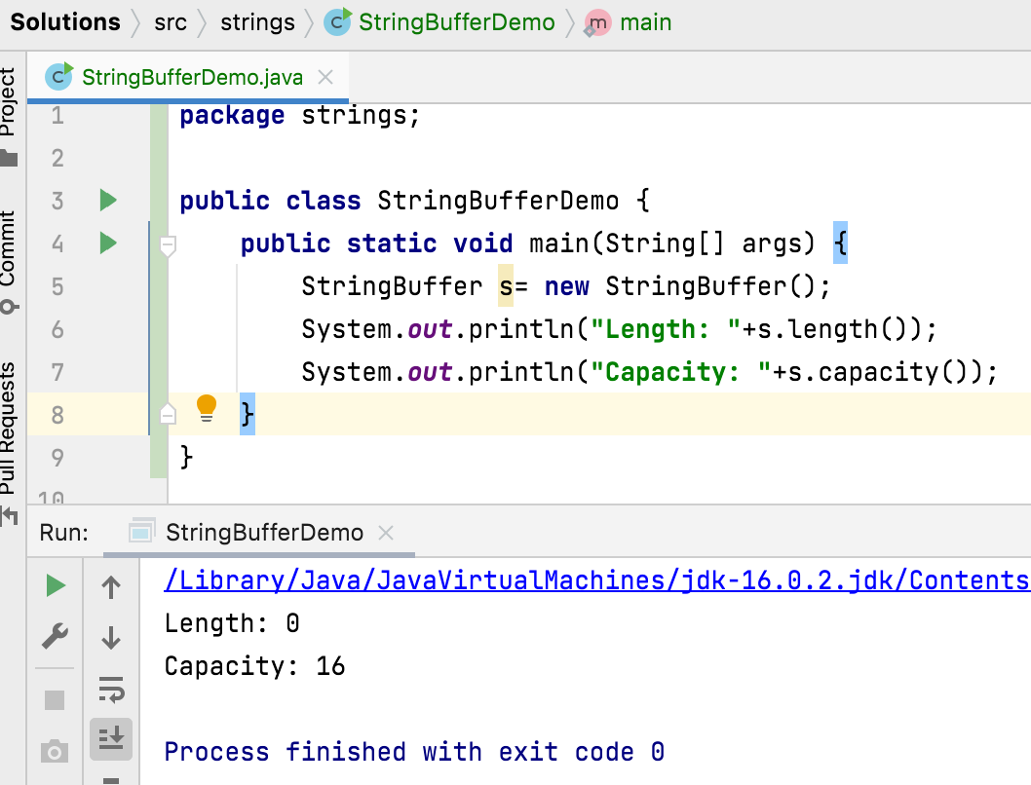
StringBuffer s= new StringBuffer(); Constructs a string buffer with no characters in it and an initial capacity of 16 characters.

Slide 4
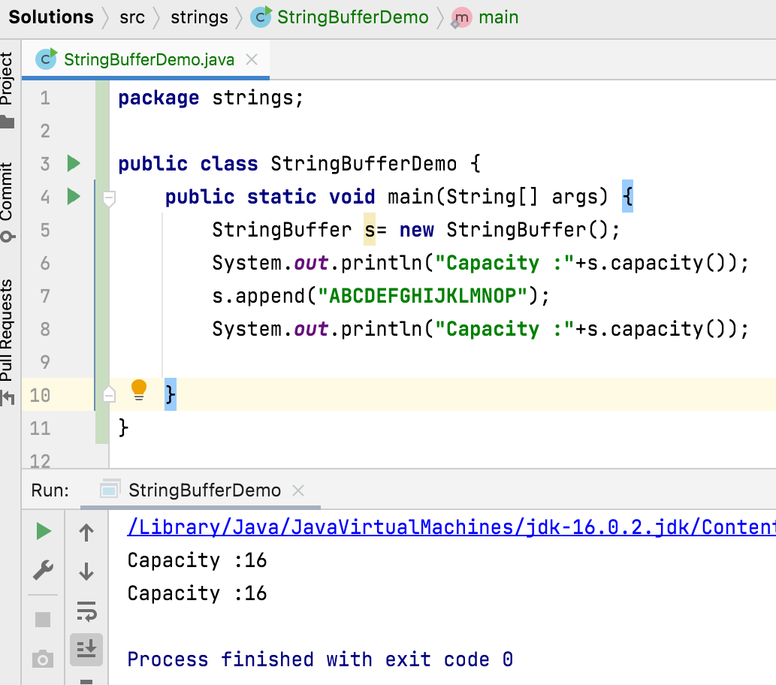
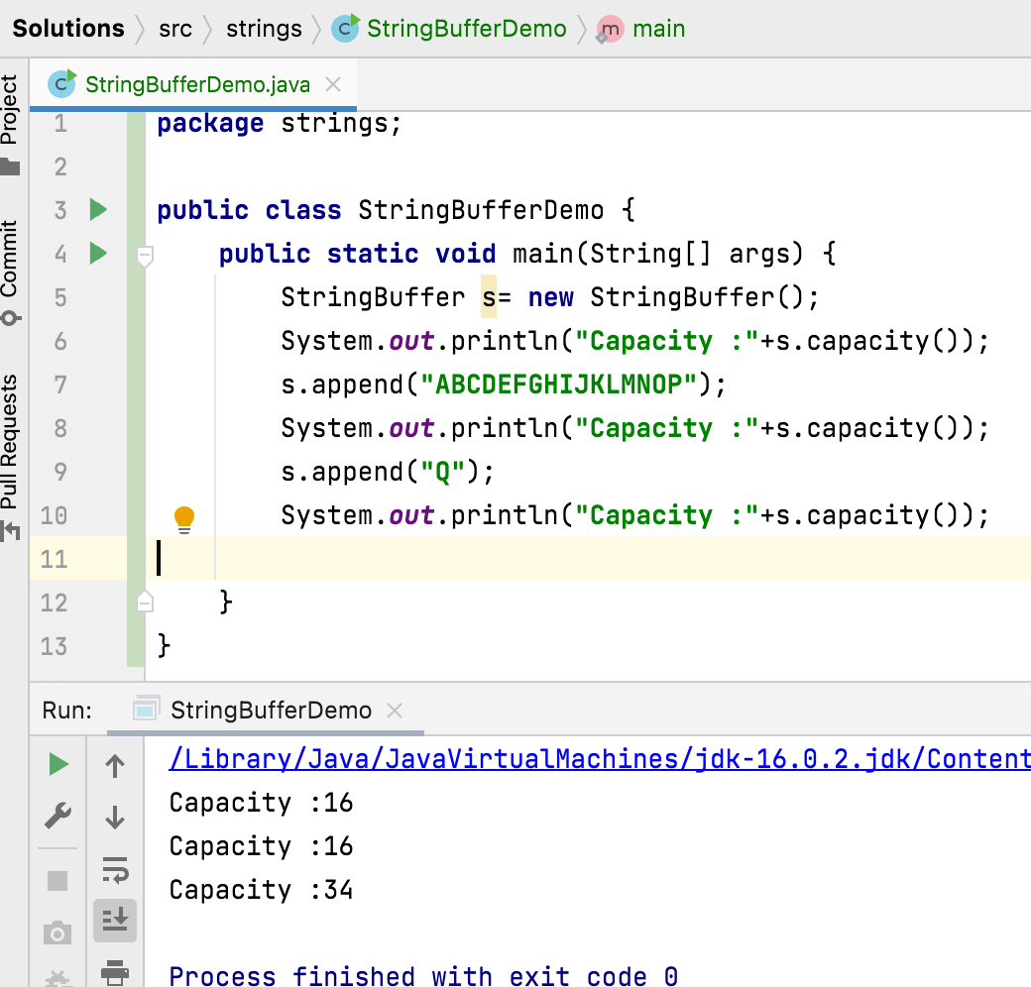
Once the String Buffer object reaches it capacity , new String Buffer Object will be created with new capacity of (Current Capacity + 1 ) * 2 and data will be shifted to newly created String buffer object and so on.

Slide 5
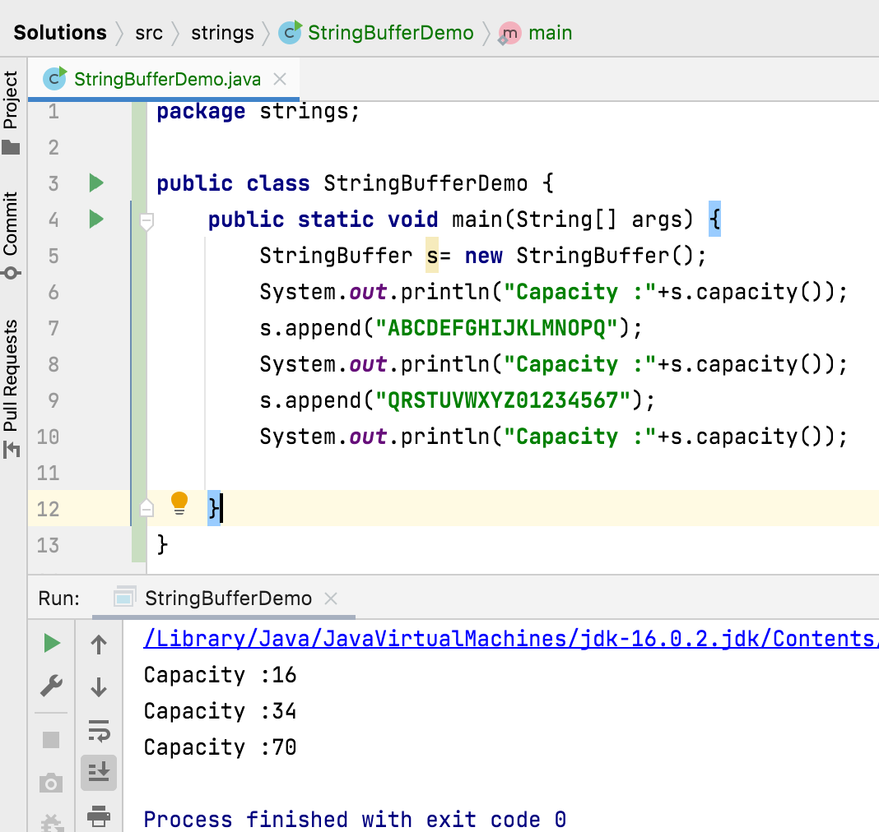

Slide 6
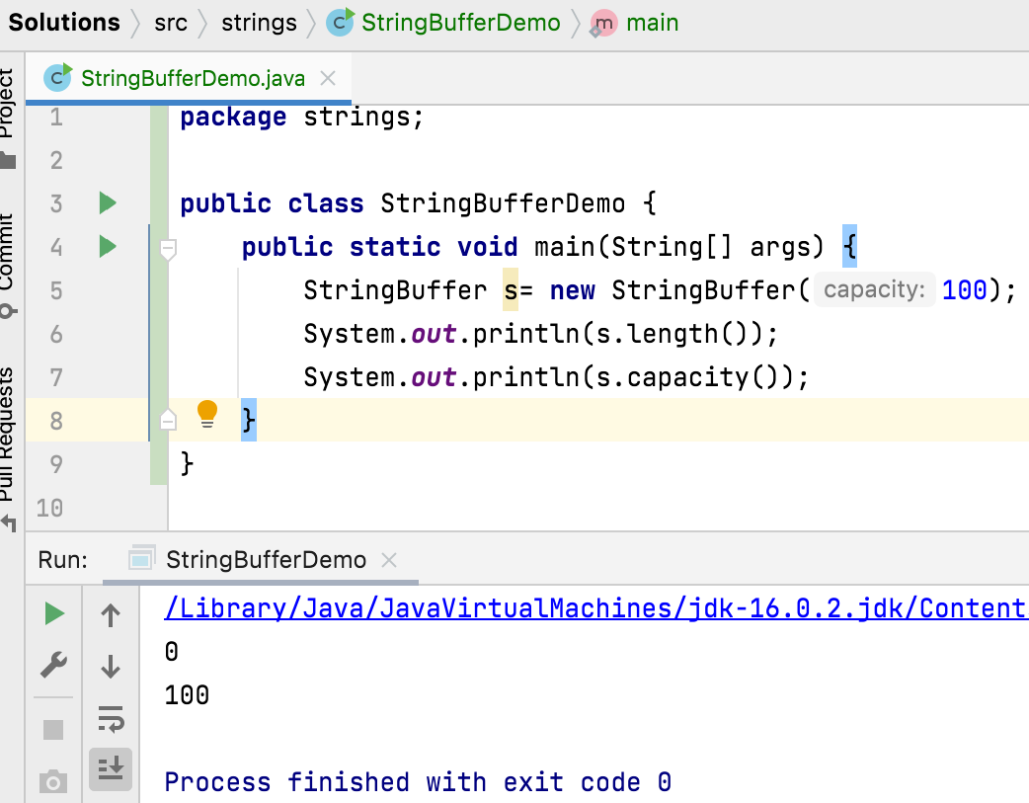
2. StringBuffer s= new StringBuffer(int capacity);
Constructs a string buffer with no characters in it and the specified initial capacity. And this constructor may throw NegativeArraySizeException - if the capacity argument is less than 0.

Slide 7
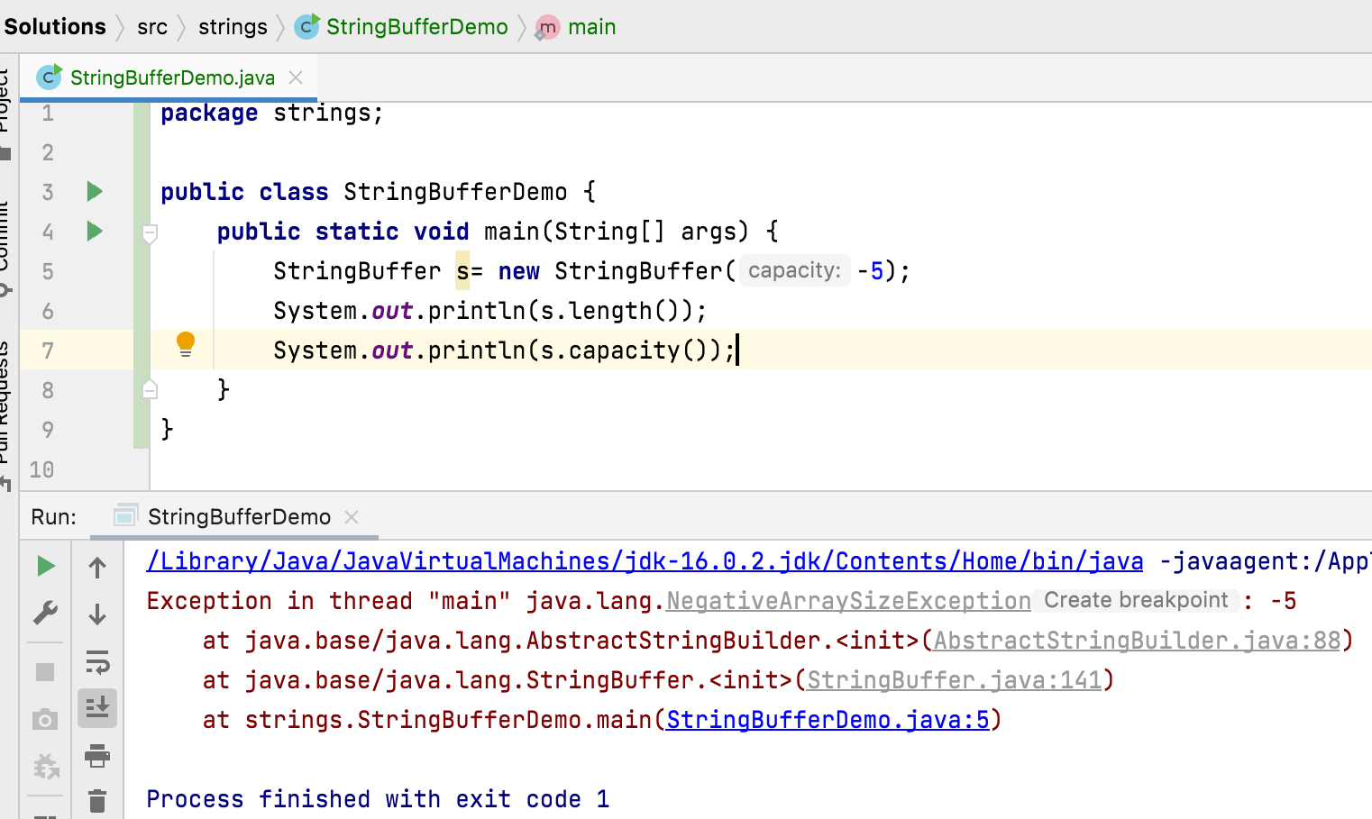

Slide 8
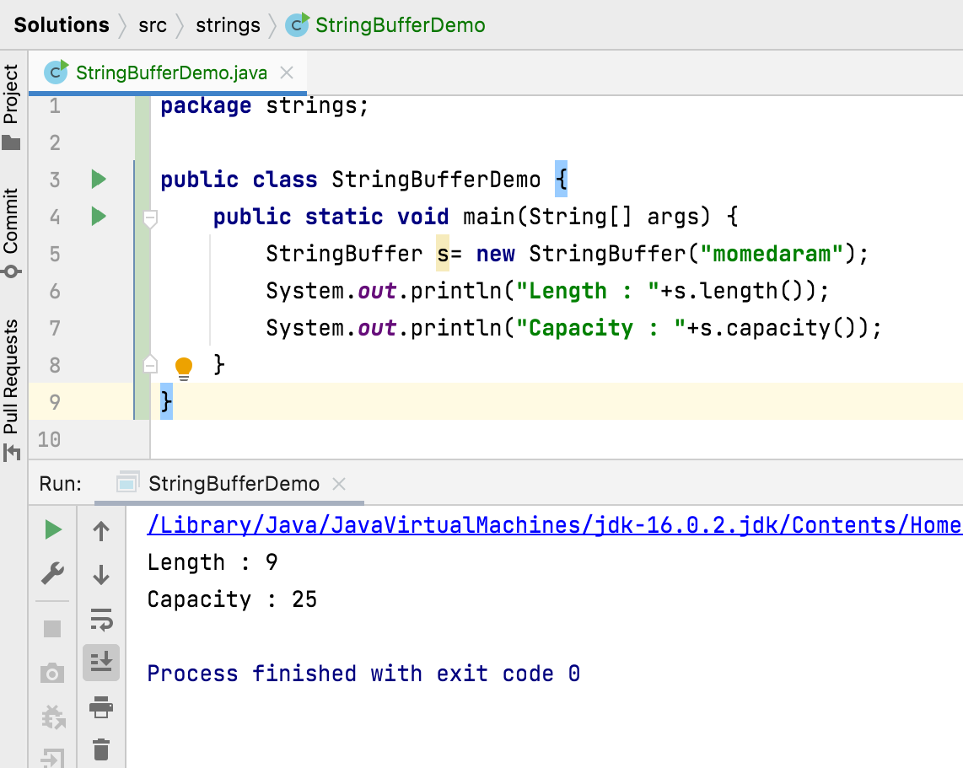
3. StringBuffer s = new StringBuffer(String str)
Constructs a string buffer initialized to the contents of the specified string. The initial capacity of the string buffer is 16 plus the length of the string argument.
And This constructor may throw, NullPointerException - if str is null.

Slide 9
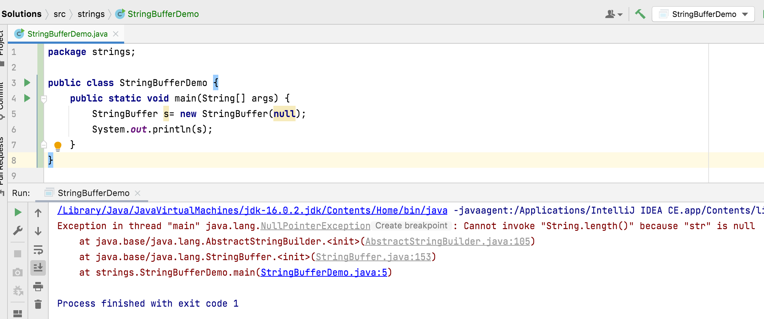

Slide 10
4. StringBuffer s = new StringBuffer(CharSequence seq)
Constructs a string buffer that contains the same characters as the specified CharSequence.
The initial capacity of the string buffer is 16 plus the length of the CharSequence argument.
If the length of the specified CharSequence is less than or equal to zero, then an empty buffer of capacity 16 is returned.
And This constructor may throw, NullPointerException - if seq is null.

Slide 11
Thank You !
momedaram

